Slide 1
Departmental Sn@pshot University Services

Slide 2
Departmental Sn@pshot - University Services
Objective:
To get the SCAD/DCS community thinking about new ways to better utilize ServiceNow at Princeton
Agenda:
The Boring Stuff (BUT IMPORTANT)
SCAD/DCS Departmental Overview
USS IT Overview (Advanced Dashboarding)
Questions?
Important Links:
https://bit.ly/2U2SNEj – Building your first Dashboard and Reports
https://github.com/kgthree/snap - Slide Deck and Tutorial

Slide 3
Who/What is University Services?
University Services provides an integrated set of services throughout the campus community. Our focus is to execute critical administrative functions that provide daily services – ranging from mail delivery and parking to housing and dining functions – to our students, faculty, staff and visitors.
Campus Dining
Event and Venue Support Services
Housing and Real Estate Services
Tigercard, Parking and Transportation
Print and Mailing Services
Trademark Licensing and Contracts

Slide 4



The Boring Stuff (Communication)
USS-IT@PRINCETON.EDU

Slide 5



The Boring Stuff (Expectations)

Slide 6


The Boring Stuff (What we support)
Frist Package Lockers
Computer Replacements
Anything OIT breaks

Slide 7
SCAD/DCS Departmental Overview Dashboard
Gaining departmental IT insights previously unavailable
Dynamic to fit the needs of any department on campus
Department Workload, Asset Tracking, Outages and Alerts, and Software Status

Slide 8
Some Background
So this view is what many SCAD/DCS are
used to seeing.
This view is familiar and was originally
meant to emulate OPM
However, I found myself wanting and needing more as our business evolved
over the years

Slide 9
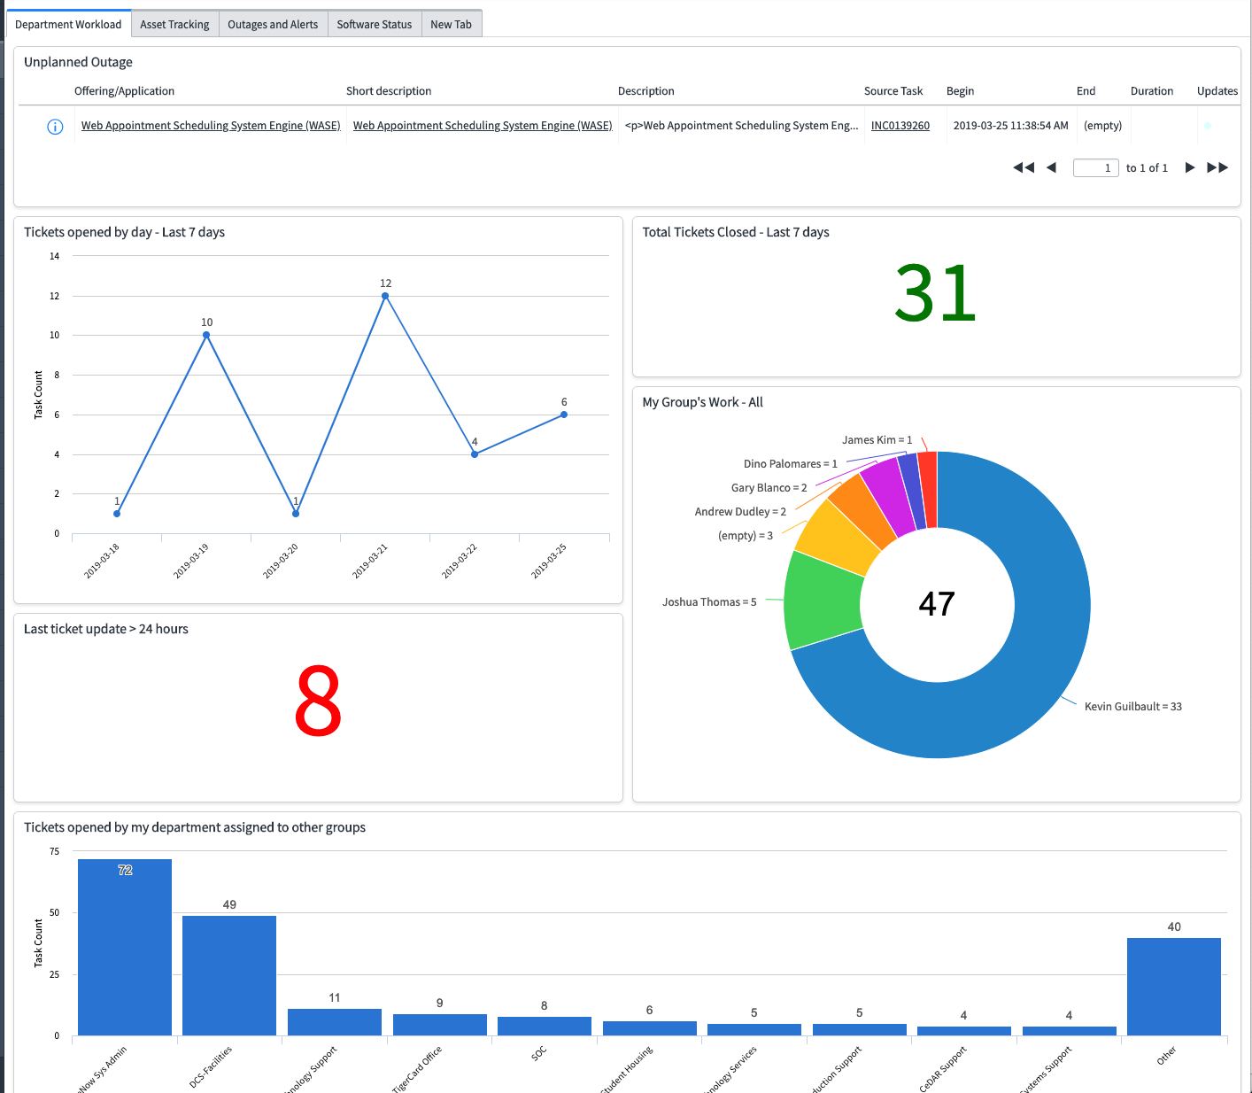
Departmental Workload
Unplanned Outages
Tickets opened by day – Last 7 days
Total Tickets Closed – Last 7 days
Last ticket update > 24 hours
My Group’s Work – All
Tickets opened by my department assigned to other groups

Slide 10
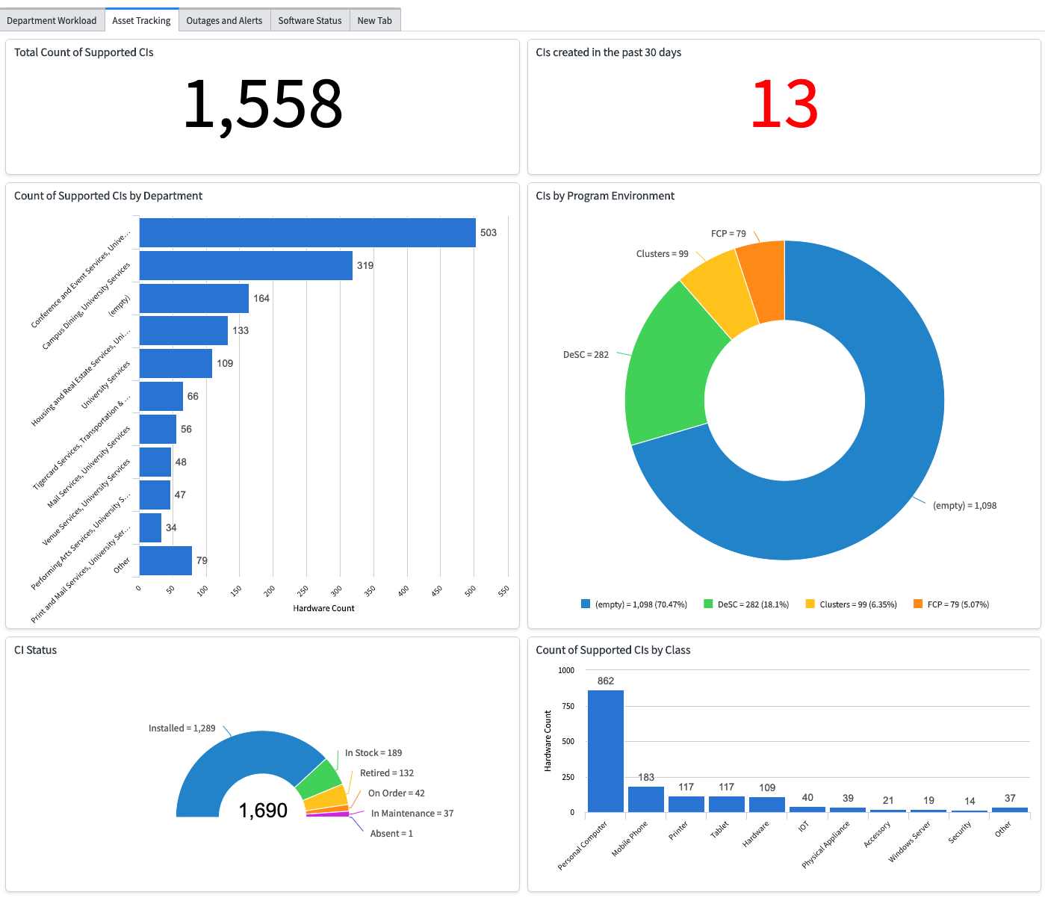
Asset Tracking
Total Count of Supported CIs
CIs created in the past 30 days
Count of Supported CIs by Department
CIs by Program Environment
CI Status
Count of Supported CIs by Class

Slide 11
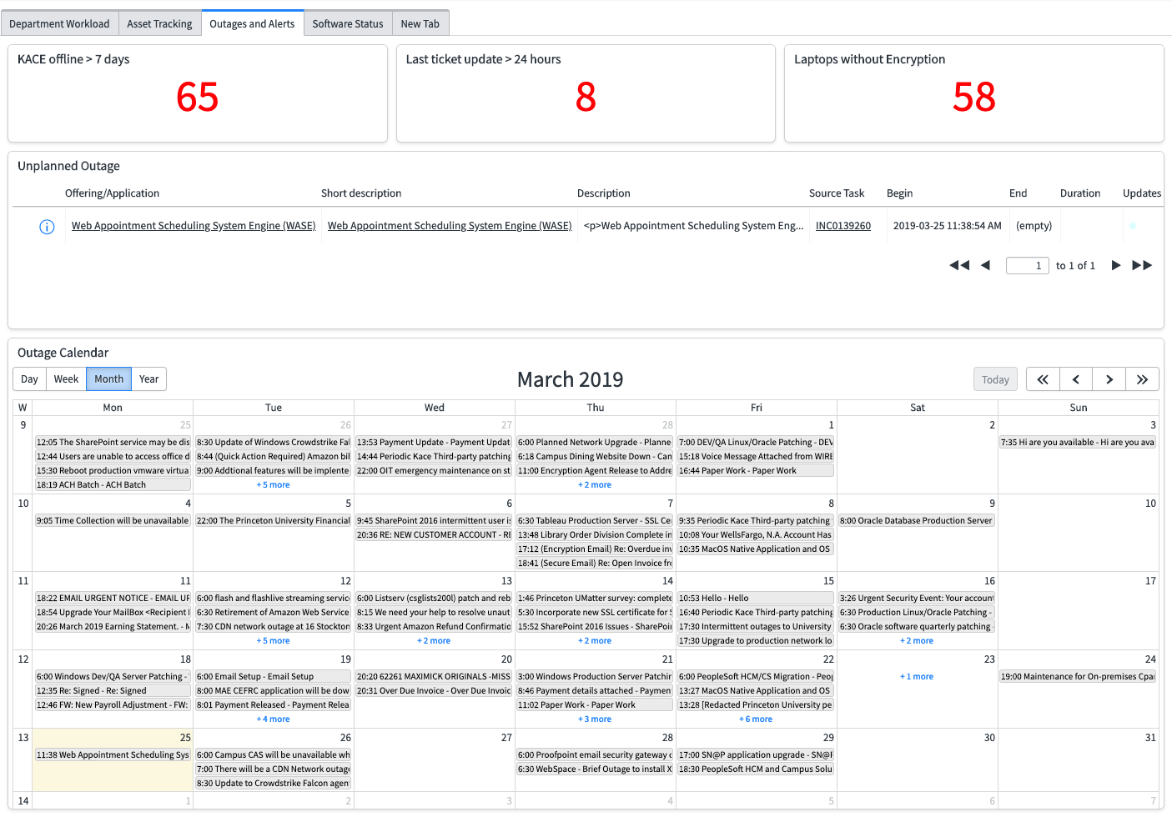
Outages and Alerts

Slide 12
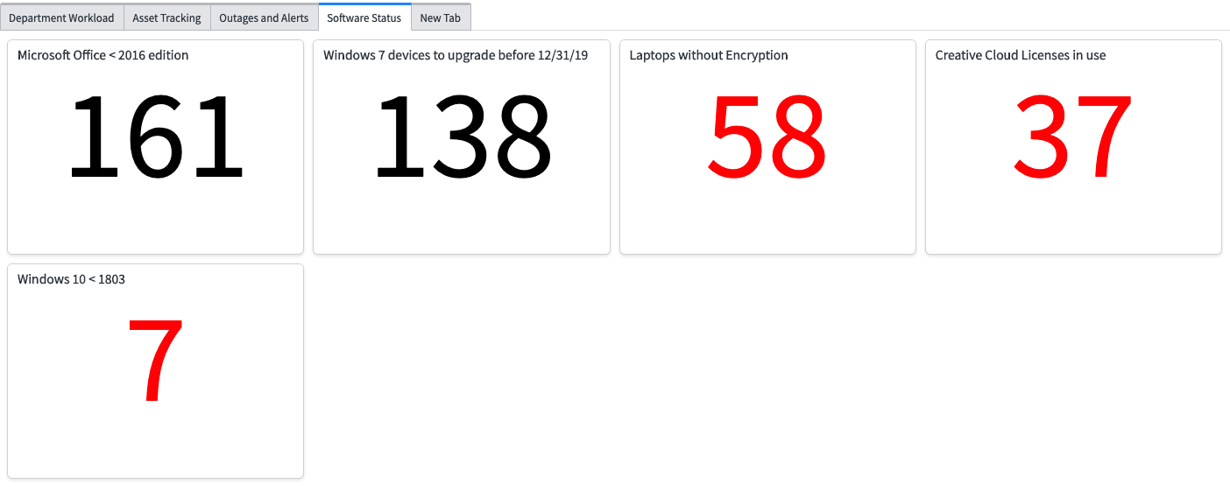
Software Status

Slide 13
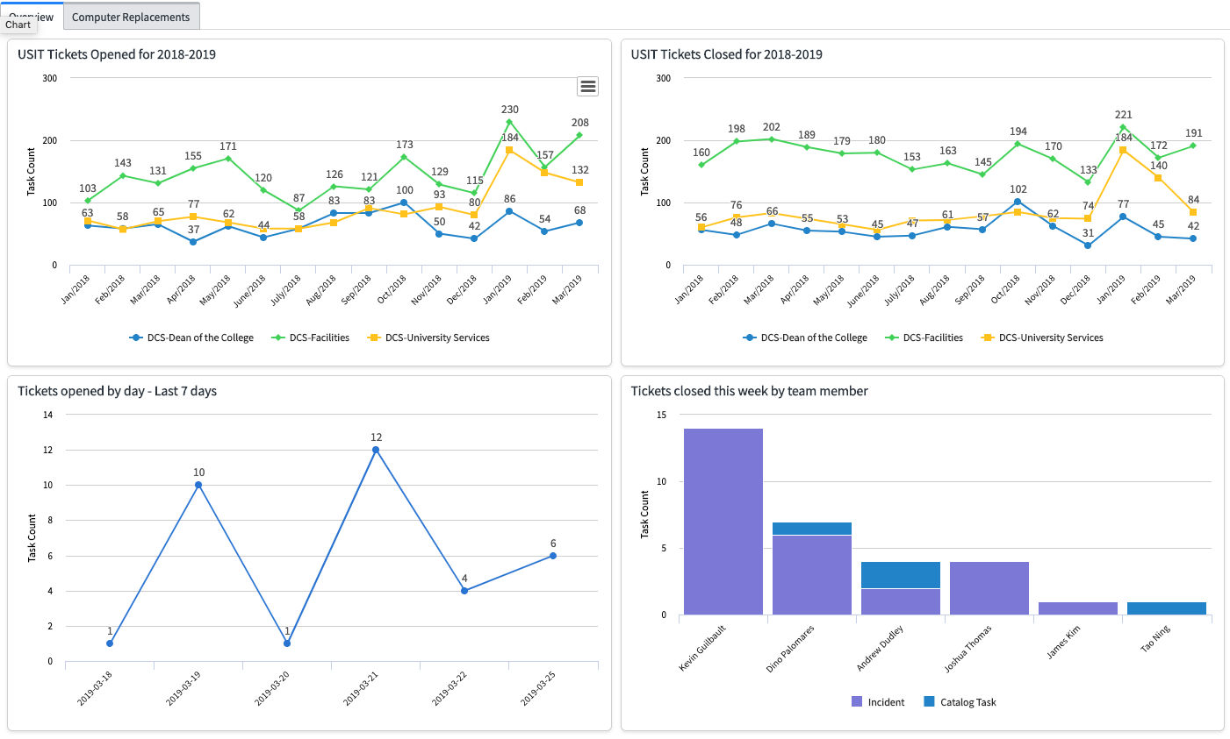
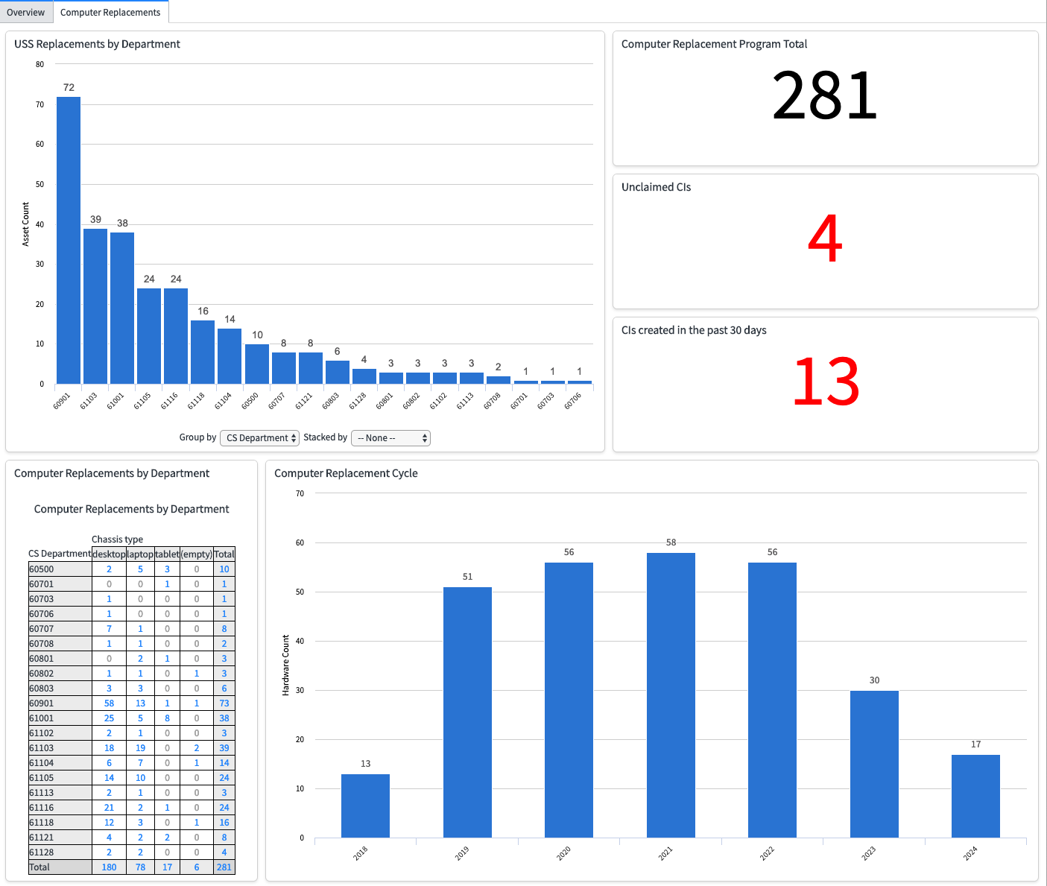
Advanced Reporting
Departmental Comparisons
Computer Replacement Program

Slide 14
Building your own custom report
Refer to handouts from class

Slide 15
Questions and Answers
ASK ANY QUESTIONS YOU HAVE NOW!

